Slide 1
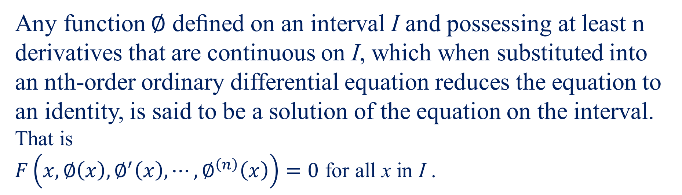
Solution of an ODE
Any function $∅$ deﬁned on an interval I and possessing at least n derivatives that are continuous on I, which when substituted into an nth-order ordinary differential equation reduces the equation to an identity, is said to be a solution of the equation on the interval.
That is
$F\left(x,∅\left(x\right),∅^{′}\left(x\right),⋯,∅^{\left(n\right)}\left(x\right)\right)=0$ for all x in I .
However, for convenience we write solution as $y(x)$.
.

Slide 2
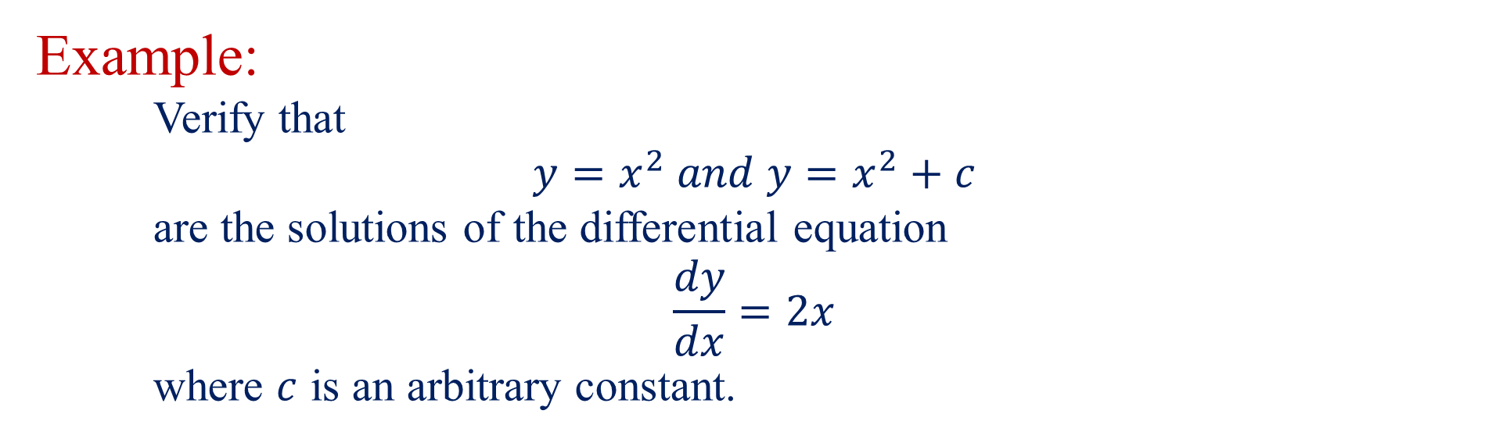
Example:
Verify that
$$y=x^{2} and y=x^{2}+c$$
are the solutions of the differential equation
$$\frac{dy}{dx}=2x$$
where $c$ is an arbitrary constant.

Slide 3
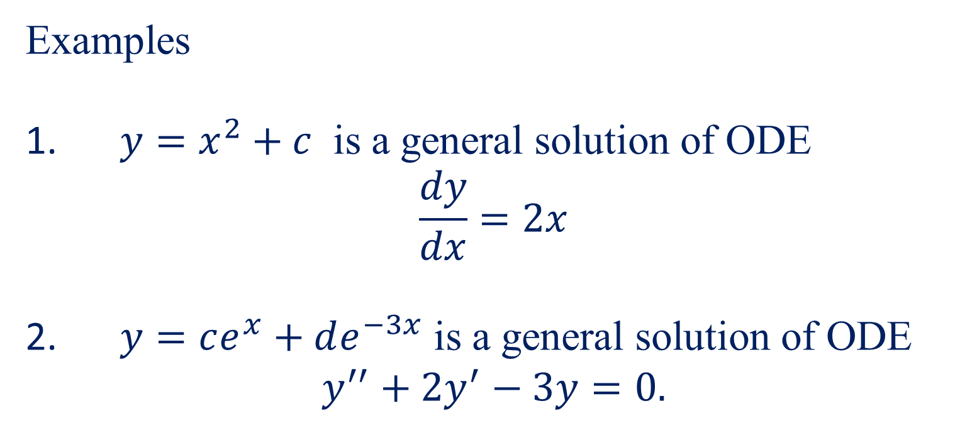
General Solution of an ODE
The solution of an nth-order ordinary differential equation which contains n essential arbitrary constants is called a general solution.
Examples
1. $y=x^{2}+c$ is a general solution of ODE
$$\frac{dy}{dx}=2x$$
2. $y=ce^{x}+de^{−3x}$ is a general solution of ODE
$$y^{′′}+{2y}^{′}−3y=0.$$

Slide 4
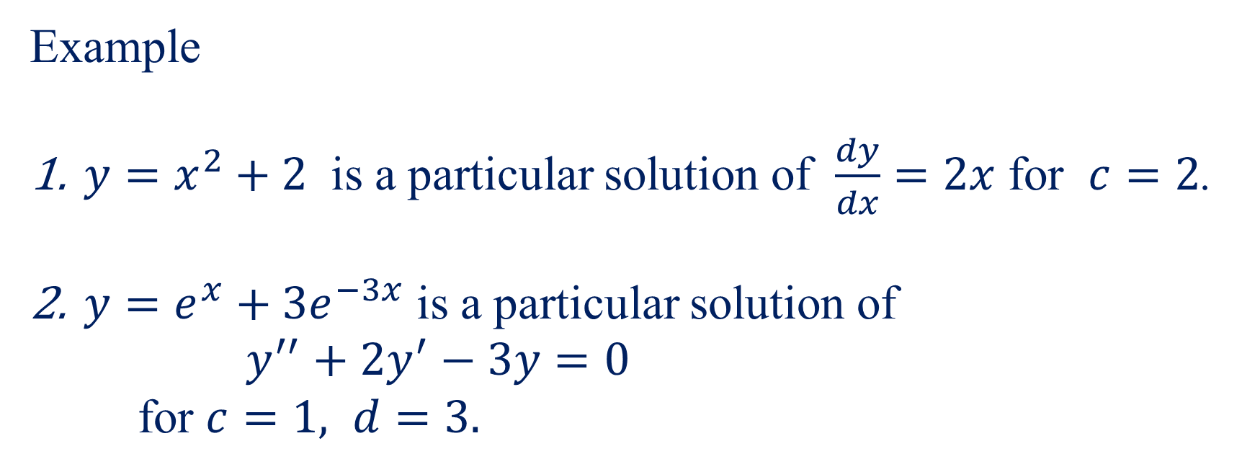
Particular Solution of an ODE
Any solution obtained from the general solution by giving particular numerical values to the arbitrary constants is called a particular solution.
Example
$y=x^{2}+2$ is a particular solution of $\frac{dy}{dx}=2x$ for $c=2$.
$y=e^{x}+3e^{−3x}$ is a particular solution of
$y^{′′}+{2y}^{′}−3y=0$
for $c=1, d=3.$

Slide 5
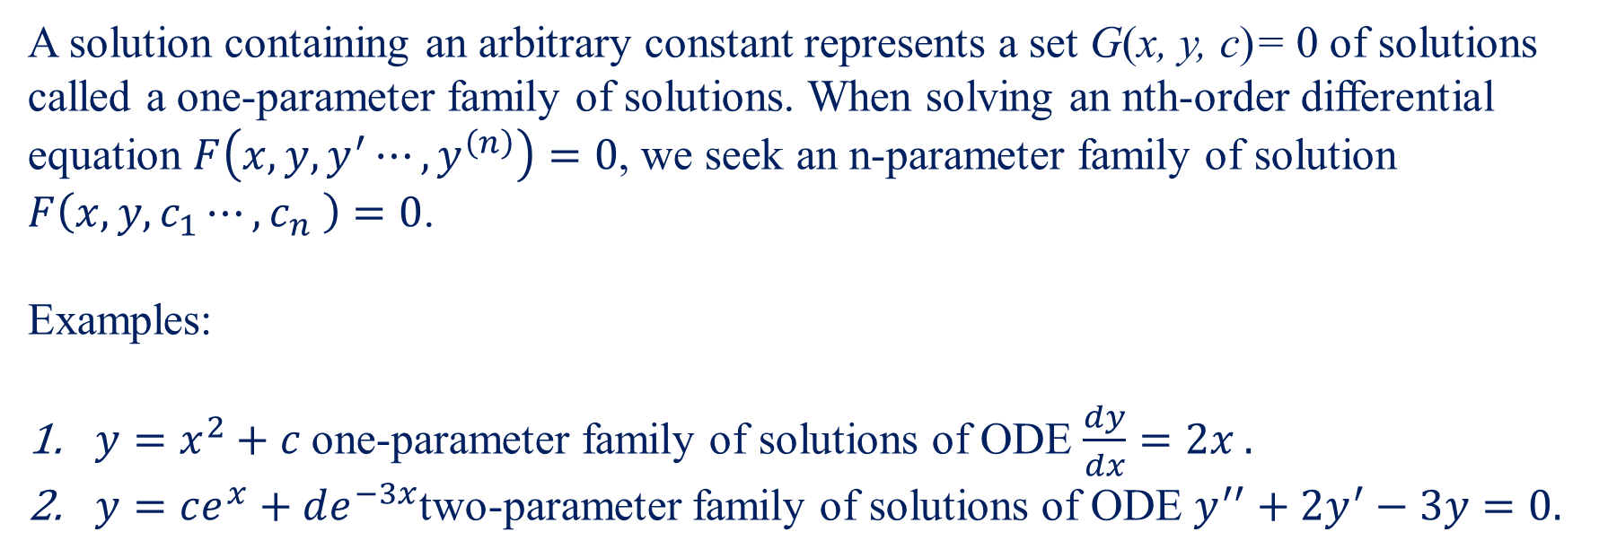
Families of Solution
A solution containing an arbitrary constant represents a set G(x, y, c)= 0 of solutions called a one-parameter family of solutions. When solving an nth-order differential equation $F\left(x,{y,y}^{′}⋯,y^{\left(n\right)}\right)=0$, we seek an n-parameter family of solution $F\left(x,y, c_{1}⋯,c_{n} \right)=0$.
Examples:
$y=x^{2}+c$one-parameter family of solutions of ODE $\frac{dy}{dx}=2x .$
$y=ce^{x}+de^{−3x}$two-parameter family of solutions of ODE $y^{′′}+{2y}^{′}−3y=0.$
Note:
This means that a single differential equation can possess an inﬁnite number of solutions corresponding to the unlimited number of choices for the parameter(s).

Slide 6
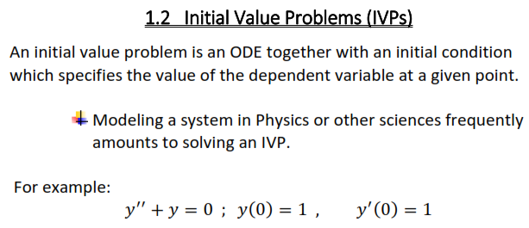

Slide 7
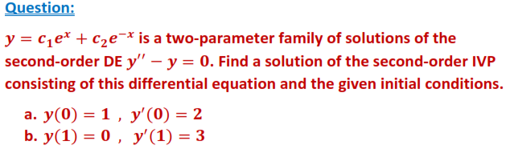
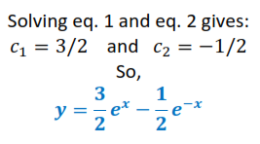
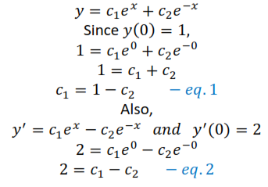


Slide 8
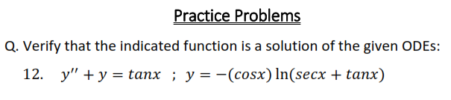

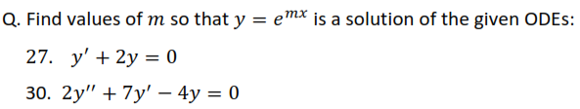

Slide 9
